Slide 1
Vulcan Activity Tracker
CMSC-4920-Senior Project 2
Group2
Team: Margo Bonal, John Gerega, Luke Ruffing

Slide 2
Project Description
The Vulcan Activity Tracker is an athletic app that allows for the tracking of all campus athletics activities.
In one combined platform, the Vulcan Activity Tracker aspires to meet student organization needs, social interaction, and exercise goal planning in a free accessible way!

Slide 3
Weekly Progress
GOALS
Finish Friends feature data displays
Finish settings page
Azure Student Hosting Account Set up
Teams Page Progress
Challenges Page Progress

Slide 4
Challenges
Solutions
Could not populate database tables with athlete emails, they were not publicly available. Also, the amount of athletes would have been a lot of inserts into the database table
Adding pictures to challenges
Populated the database tables with coach emails instead, as this information was publicly available and it becomes more efficient to let the coach into the page and invite their athletes as opposed to having every single athlete in the table on startup
Decided not to use pictures for individual challenges as it will fill the database quickly

Slide 5
Progress
Vulcan Platform
Database

Slide 6
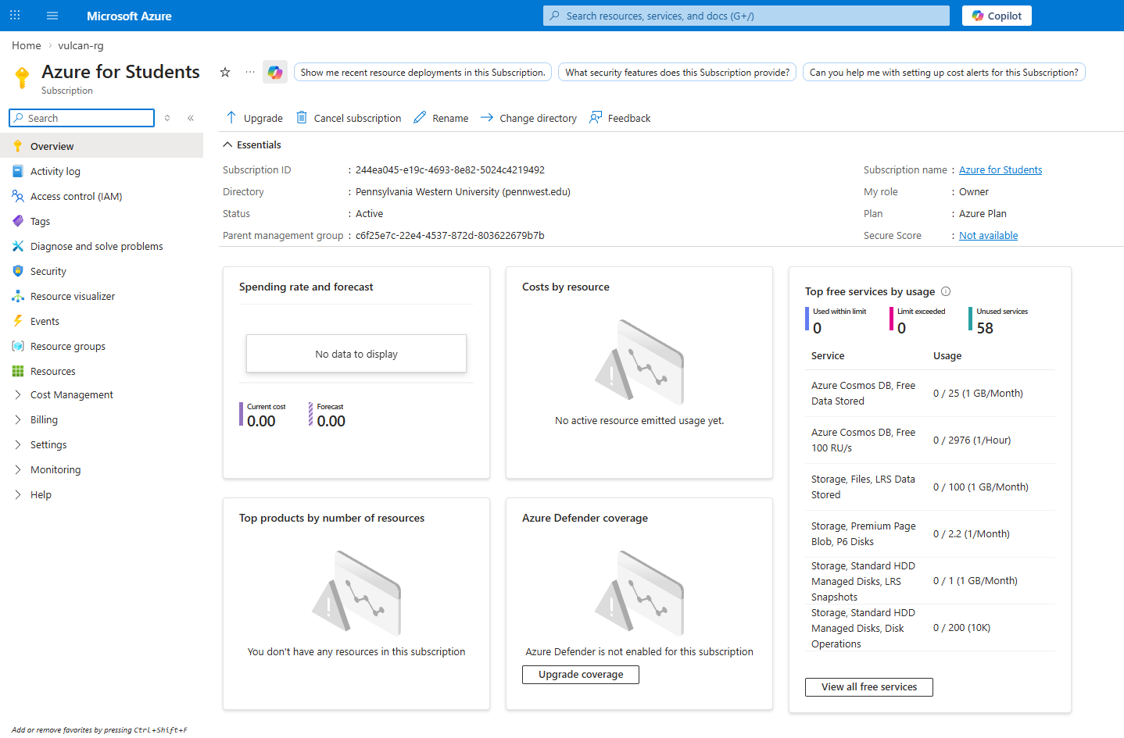

Slide 7
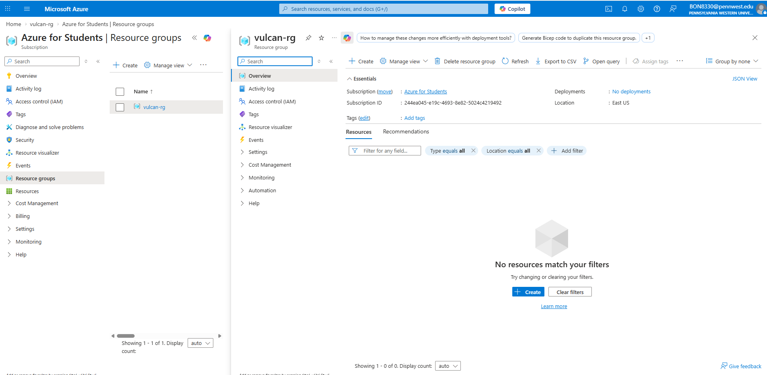

Slide 8
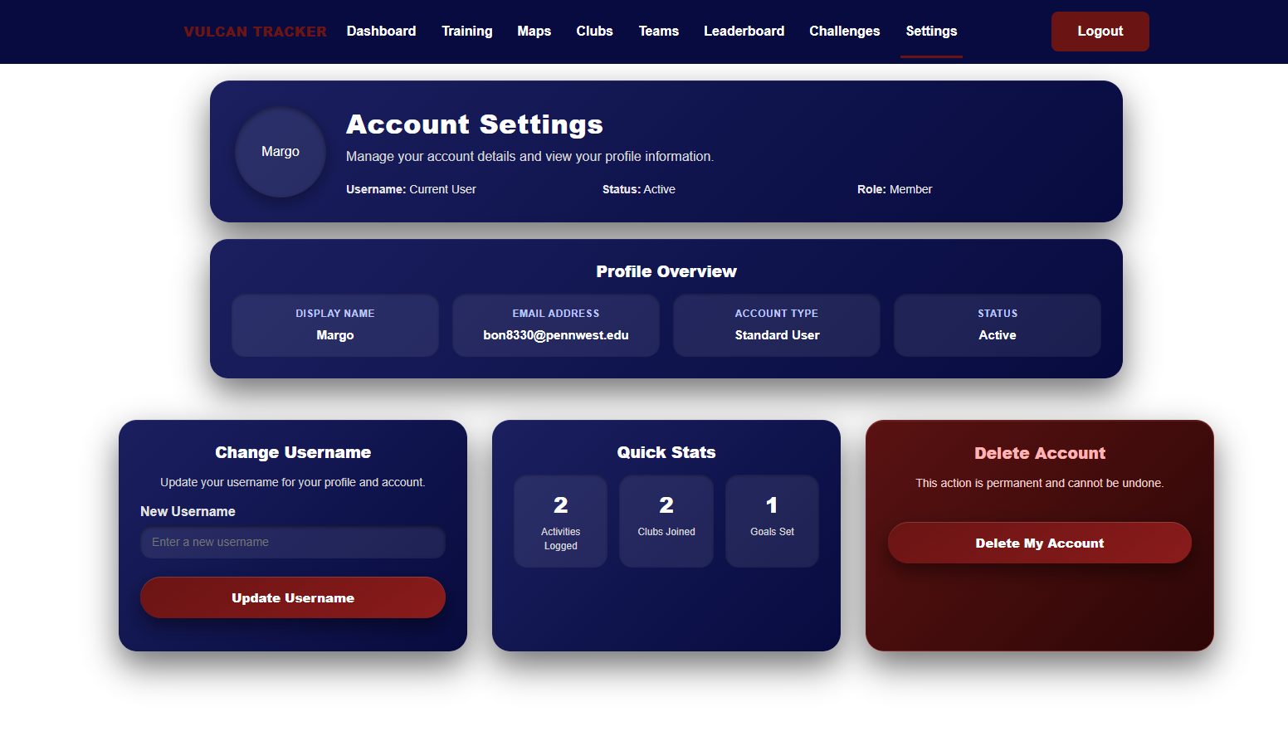

Slide 9
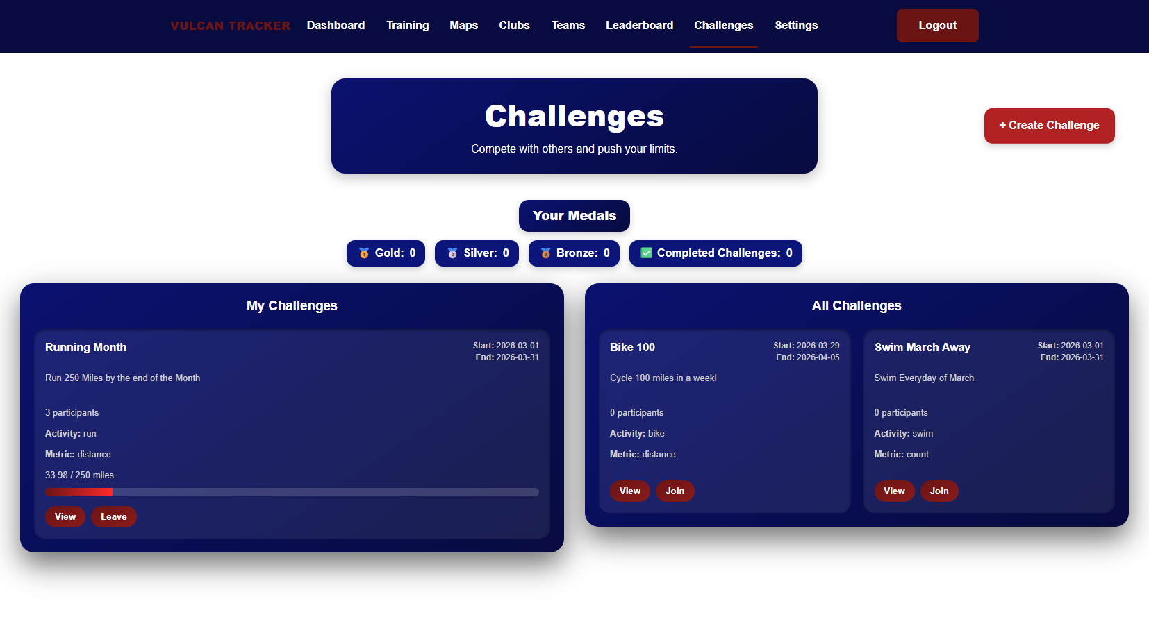

Slide 10
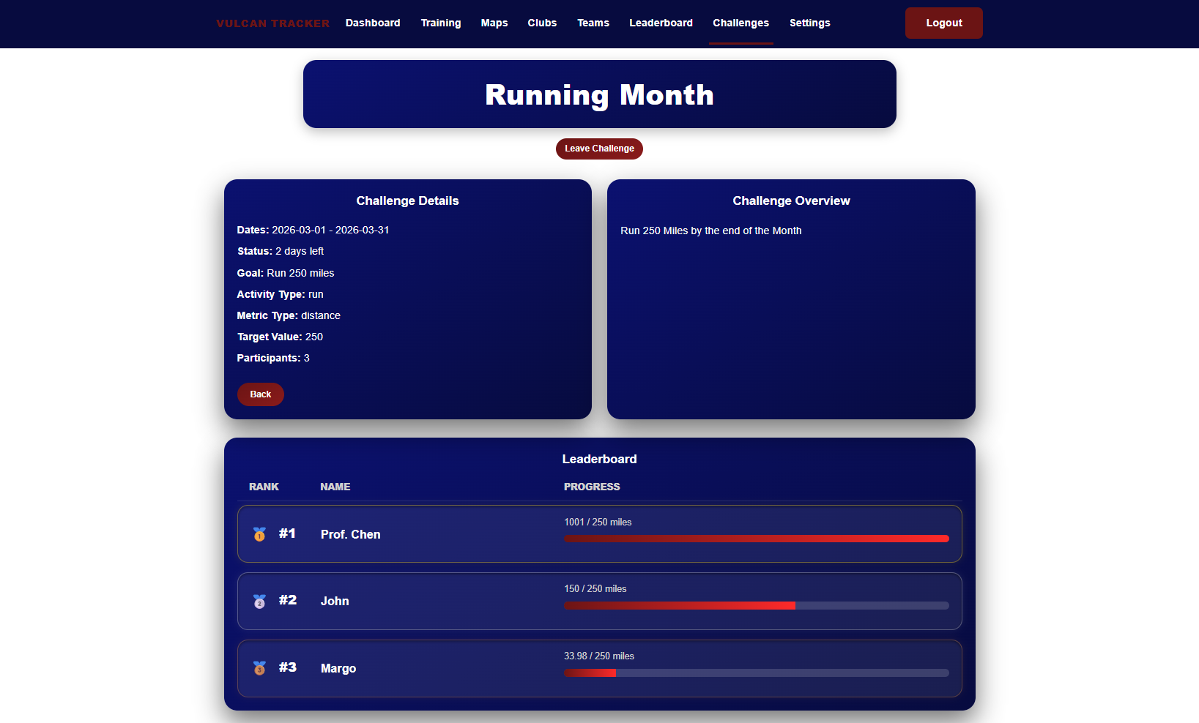

Slide 11

Teams Page

Slide 12
Week 12 Plan
Finalize Components
Debugging
Hosting Progress
Finish Teams Page

Slide 13
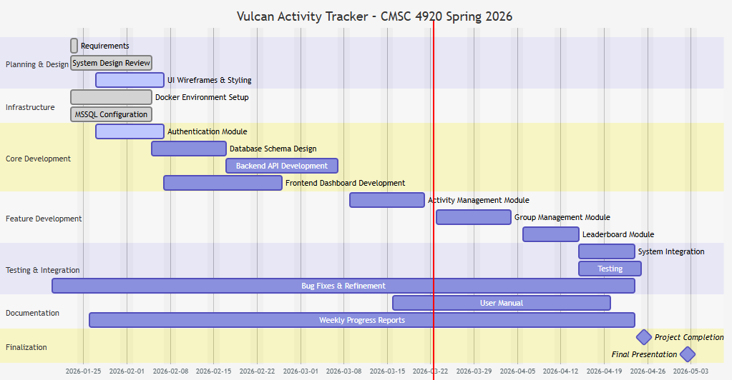
Planning
Gant chart

Slide 14
Website: https://jjdeuce06.github.io/VulcanActivityTracker/

